Slide 1

Project 2
Ames Housing Price
Presented by:
Jerome,
Janet,
& Chee wee

Slide 2
Content
Problem Statement
Dataset Introduction
Data Cleaning and EDA
Preprocessing and modeling
Evaluation and Conceptual understanding
Conclusions and Recommendation

Slide 3
Introduction and Problem Statement
Target Audience
Sellers and buyers in the housing market
Problem Statements
Our main aim for this project is to utilize regression modelling to identify features that can be useful in predicting the housing sale price. The predictive modelling that we obtain for this project can be useful to house owners who are planning to sell their houses. They would be able to understand the features that have an influence on the value of their homes so that they will be able to better set the sale price for their own homes. For buyers of houses, this can assist them to understand better the value of the houses that they are buying by looking out for features that will influence the sale price of a house.

Slide 4
Dataset introduction
We will be using the following data set for the analysis on this project.
Train.csv: Ames housing data set
In this data set, there are a total of 81 columns and 2051 rows. Out of the 81 columns, there are 80 explanatory variables describing the different aspects of residential homes in Ames, Iowa, and 1 column which contains the sale price of the houses. There are a total of 24 nominal, 23 ordinal, 14 discrete, and 20 continuous variables.

Slide 5
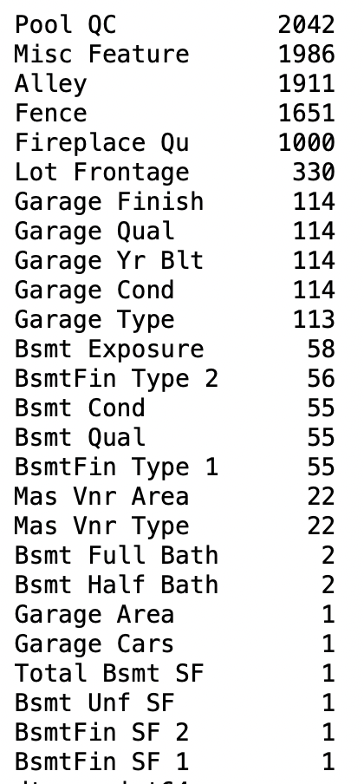
Dataset cleaning
For Pool QC, we understand that NA value means that there is no pool. Therefore, for this column, we will substitute NA as None.
For Misc Feature, we understand that NA value means that there are no miscellaneous features. Therefore, for this column, we will substitute NA as None.
For Alley, we understand that NA value means that there is no alley access. Therefore, for this column, we will substitute NA as None.
For Fence, we understand that NA value means that there is no fence. Therefore, for this column, we will substitute NA as None.
For Fireplace Qu, we understand that NA value means that there are no fireplaces. Therefore, for this column, we will substitute NA as None.
For Lot Frontage, we noted that there were quite a number of outliers based on our visualization, and therefore, we used the median as the value to populate for the missing values.
For the columns relating to garage (i.e. Garage Finish, Garage Qual, Garage Yr Blt, Garage Cond, Garage Type), we understand that NA values means that there is no garage. However, we noted that for the column 'Garage Type', it seems that there is one less row which was not indicated as NA. Upon investigation, we noted that there was a row in which the garage type is indicated as Detached but all related columns on garage was missing. Therefore, we will drop this row of data from our analysis. In addition, for the row in which there was an odd year of 2207, as we are not able to make an inference from any columns to determine the Garage year built, we will drop this row from our analysis.

Slide 6
Dataset cleaning
For Mas Vnr Type and Mas Vnr Area, we understand that NA value means that there are no Mas Vnr type. Therefore, for this column, we will substitute NA as None for Mas Vnr and substitute NA as 0 for Mas Vnr Area.
For basement full bath and basement half bath columns, upon our investigation, we noted that the 2 rows in which NA is indicated for the column 'Basement Full Bath' are the same rows in which NA is indicated for the column 'Basement Half Bath'. As we understand that there are no basements for these 2 rows, we will replace NA with 0 accordingly.
For the columns relating to Bsmt Exposure, BsmtFin Type 2, Bsmt Cond, Bsmt Qual, BsmtFin Type 1, we noted that there were 55 rows which are NA for Bsmt Cond, Bsmt Qual, BsmtFin Type 1 which would indicate that there is no basement. However, for the other 2 columns, there are 58 and 56 rows which are NA respectively. Upon investigation, we noted that there were 3 rows in which the basement quality is indicated as Gd and the basement condition is indicated as TA but information on basement exposure is missing. Therefore, we will drop this 3 rows of data from our analysis.
For the remaining columns relating to basement which have missing values, as there is no basement for this house, we will indicate and replace NA with 0 for the 'Total Bsmt SF', 'Bsmt Unf SF', 'BsmtFin SF 2' and 'BsmtFin SF 1' columns.
Additionally, we conducted a cross check on the columns in which we have changed due to the missing values to ensure that it makes sense. During our cross check, we noted that there are 5 rows in the dataset in which Mas Vnr Type is indicated as None but the area was not 0. As we are not able to verify if these values are correct, we will be dropping these rows from our data set for the analysis.

Slide 7
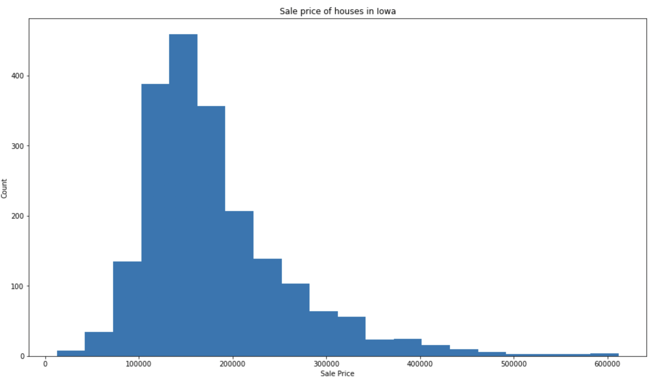
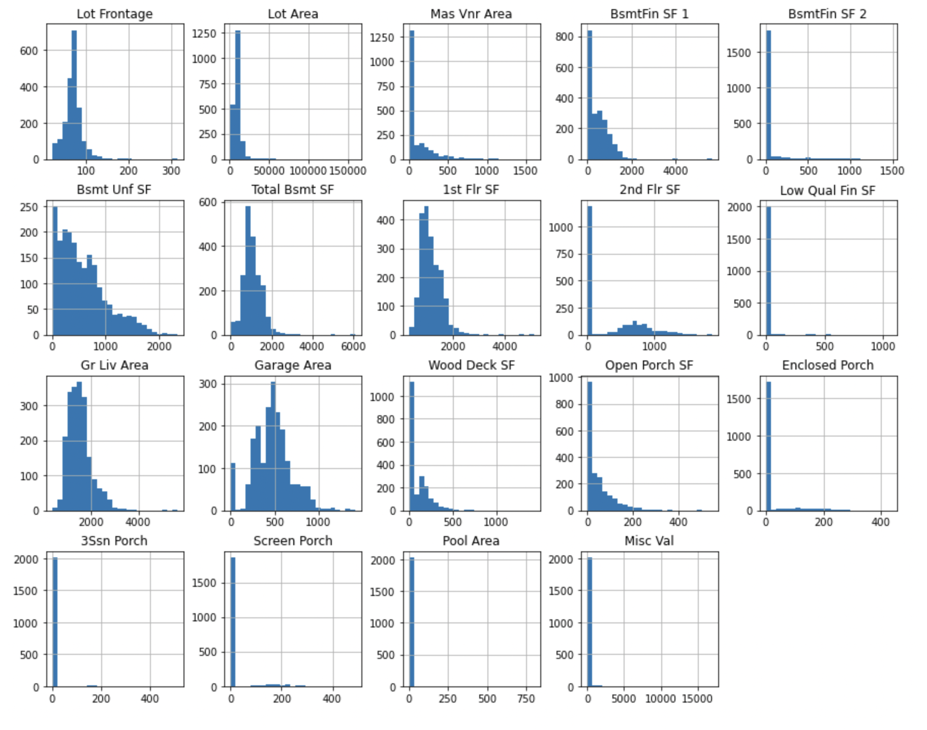
Exploratory Data analysis

Slide 8
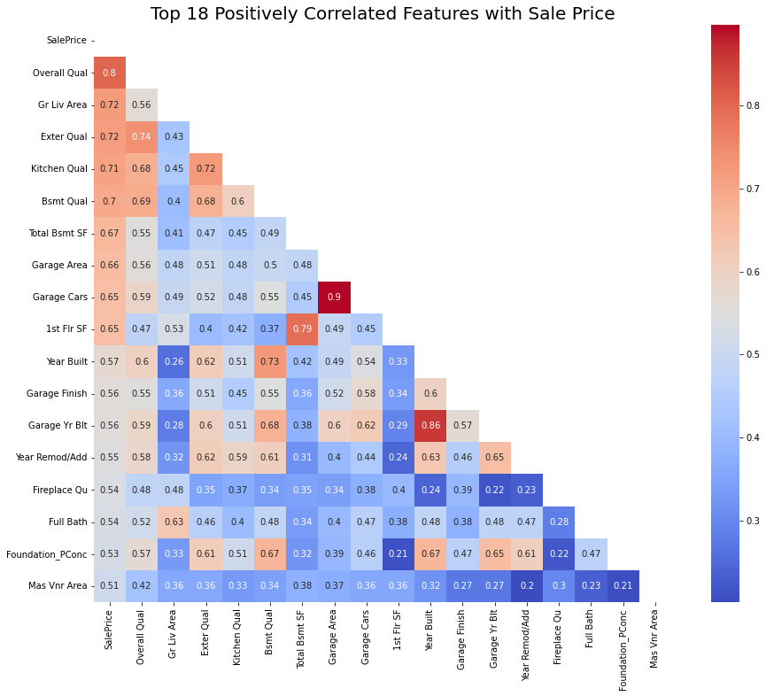
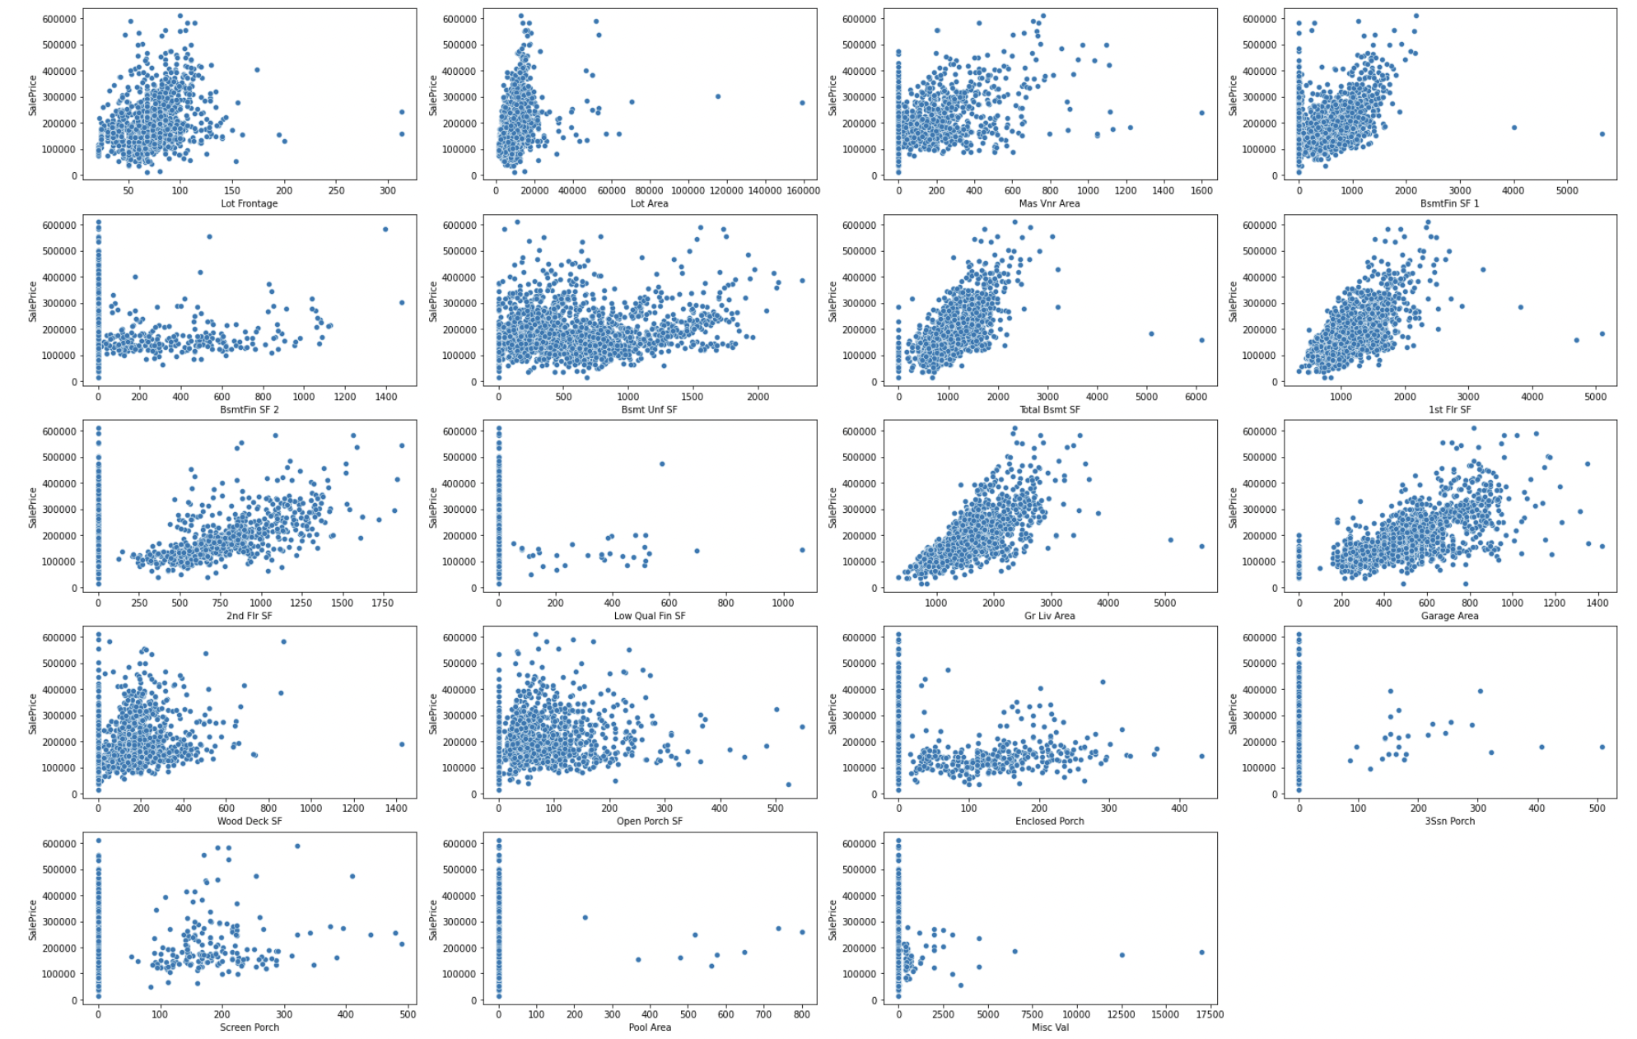
Exploratory Data Analysis

Slide 9
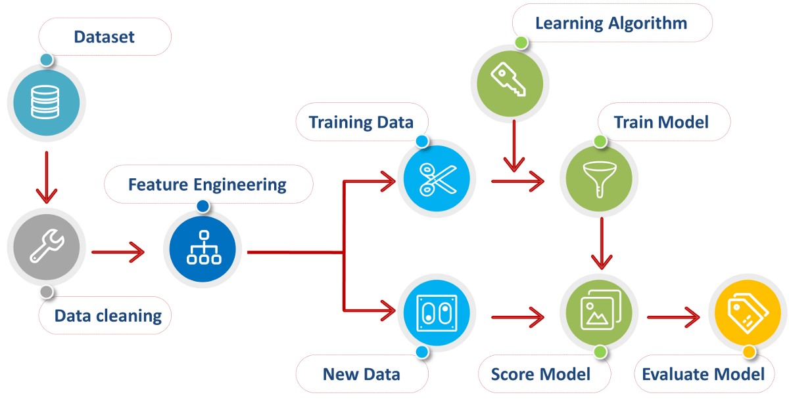
source
Notes:
Progress check, high-level and holistic view diagram
Now we’ve a clean dataset

Slide 10
Dimensionality Reduction
By dummifying, dataset shape increased from 80 to 228 features
Pros - increased dimensionality of data.
Cons - the risk of overfitting the model (noise features may be assigned non-zero coefficients due to chance associations with target variables)
Dimensionality reduction techniques:
Correlation
Variance analysis
Recursive Feature Elimination
Notes:
By dummifying variables, total number of features increased greatly from 80 - 228, on surface it increases our dimensionality of data
- L - Linear relationship
- I - Independent errors
- N - Normally distributed errors
- E - Equal variance of errors (homoscedasticity)
- M - No Multicollinearity/Independence of Predictors

Slide 11
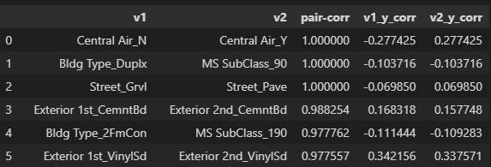
Feature Engineering - High Pairwise Correlation
|Var 1| Var 2| Pair-Corr | Var 1 vs Target | Var 2 vs Target
Identify the High Pairwise Correlated Variables
Drop or Combine Variables
Create interaction columns for Exterior features
Drop variables due to perfect pairwise correlation score of 1
Drop variables with lower absolute correlation to sale price
Combine variables (e.g. ‘Garage QualCond’)

Slide 12
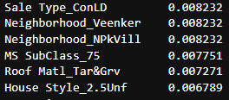
Feature Engineering - Low Variance
Variables | var < 0.009
Many features are approximately constant, do not improve model performance, these violate the multivariate normality assumption of MLR
Combine variables to make them statistically significant (e.g. ‘Sale type’, ‘Foundation’)
Drop 57 variables with variance below variance threshold of 0.009

Slide 13
Feature Engineering -
Recursive Feature Elimination
Overall Quality
Basement Full/ Half Bath
Total Bedrooms/ Kitchen/ Rooms
Fireplace
Garage Cars
Recursive Feature Elimination (RFE) - fits a lr model, rank features based on data trained algorithm and removes the weakest feature(s) until the specified number of features is reached.
Drop 28 variables
Final # of features : 120
Notes:
Steps of processing:
Decide which new features to be created from existing
Create - Check & Test - Keep if it improves the signal (legitimate relation between features and response) OR Drop if it doesn’t
RFE drops 26 variables

Slide 14
Summary of Feature Engineering
Type of variables | Method | Example/ Results
Ordinal Categorical Variables | Ordinal Encoding | 13 variables remain
Nominal Categorical Variables | One Hot Encoding | 10 variables remain
Interaction terms | Combine | Qual * Cond [Overall, Ext., Bsmt., Garage]

Slide 15
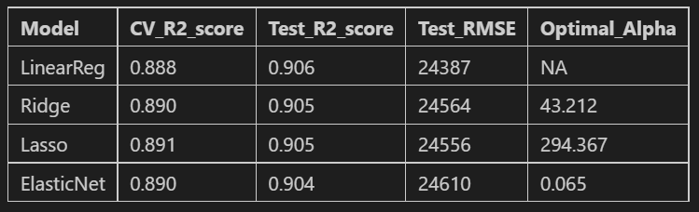
Modeling & Evaluation
Parameters:
Train-Test split : 75%-25%
StandardScaler
Model is slightly overfitting, accuracy decreased between training dataset and CV dataset
Notes:
Stnd LR, Lasso, Ridge, ElasticNet
Train-Test Split
Scaling
Instantiate and fit the model

Slide 16
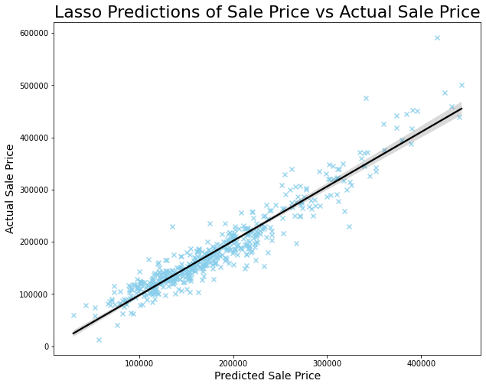
Modeling & Evaluation
LASSO Regression
R2 score: 0.91
RMSE score: $ 24,556
Strong linear relationship between predicted sale price and actual sale price
Notes:
Fit again on test set and score

Slide 17
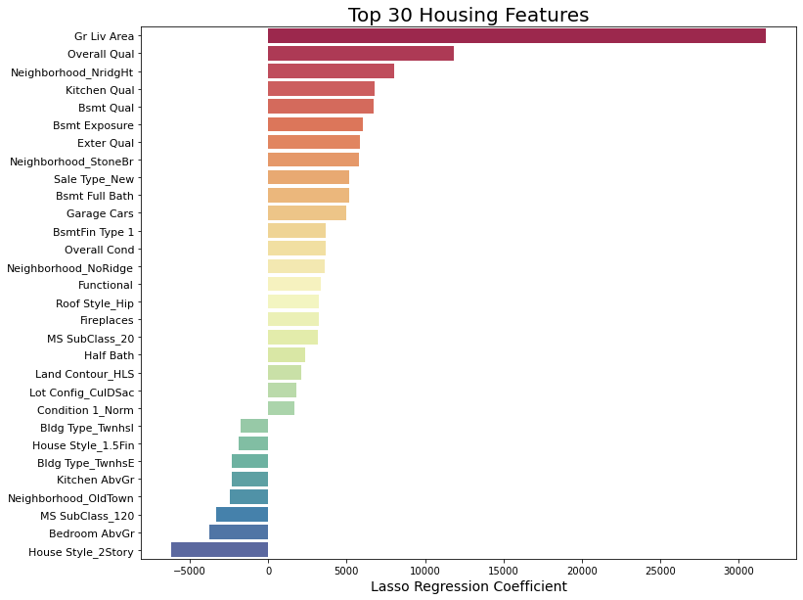
Top Housing Features
Interpreting the coefficients
Holding all else constant, for every unit increase in the Gr Liv Area, we expect an increase of $32000 to the SalePrice
Features that may add value to house price
Big house (Gr Liv Area),
Type of materials and finishing used and house condition (Overall Qual, Overal Cond)
Good Bsmt Exposure (garden, walkout basement)
New houses (Sale Type - New)
Neighbourbood Stone Brook, Northridge Heights
Notes:
Engineered feat Overall Qual, Bsmt qual, Exeter qual

Slide 18
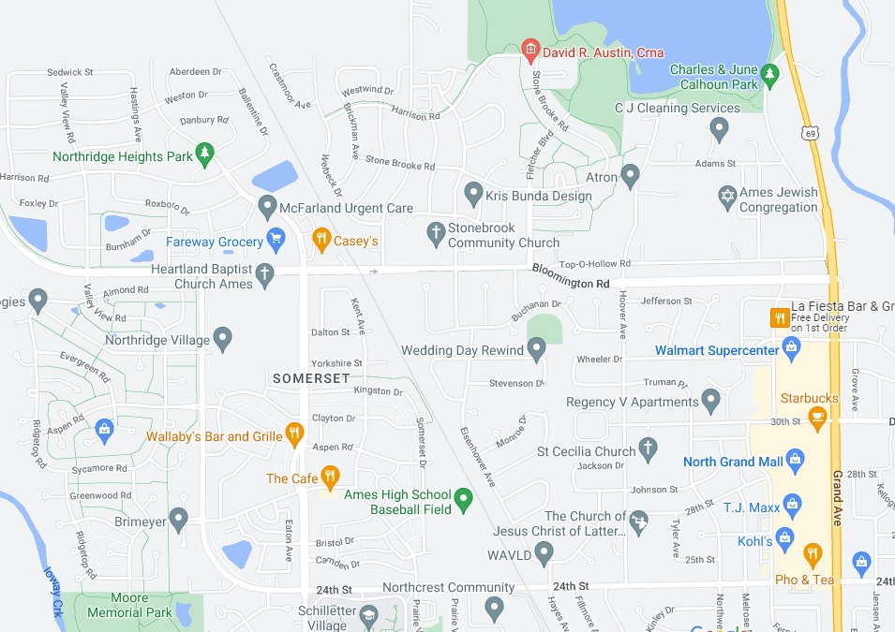
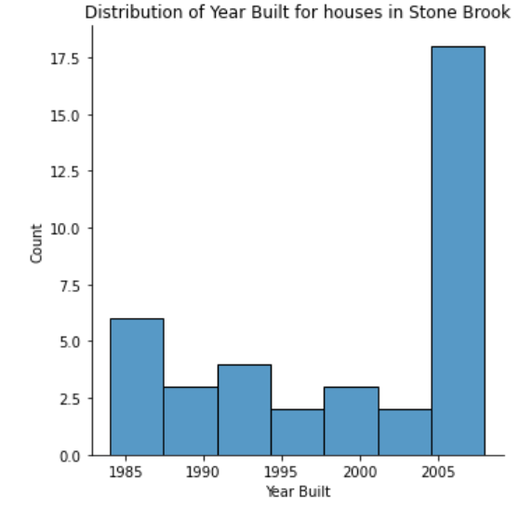
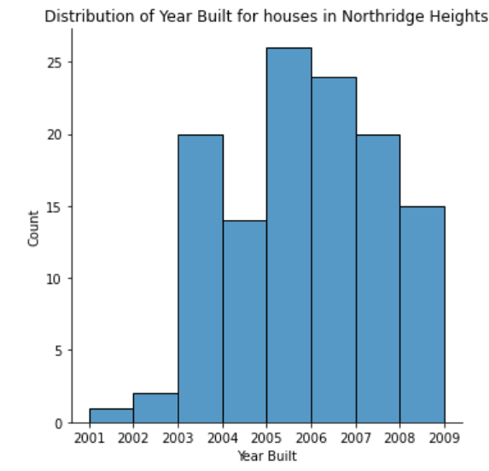
Houses in Stone Brook and Northridge Heights
Observations:
Stone Brook and Northridge Heights are nearby to each other, and a short drive to nearby open spaces, parks, food, grocery, clinic, supermarket, shopping mall, school, churches
The average size of houses in Stone Brook (1980 sqft) and Northridge Heights(1940 sqft) are bigger when compared to the average size in Ames(1500 sqft)
The houses in Stone Brook and Northridge Heights are also newer, less than 10 years old from 2010
The observations are consistent with the features that may add value
Stone Brooks
Northridge Heights

Slide 19
Conclusion & Recommendation
Conclusion
A production model is developed to predict the prices of houses in Ames, Iowa using R2 as the selection metric. The analysis has also found the following strong predictors of house prices
Big houses - Big living area (Gr Liv Area)
New houses - New sales (Sales type - New)
Open - garden/walkout basement (Bsmt Exposure)
Used very good materials and finishing and are in very good condition(Overall Qual, Overall Cond)
Neighbourhood that command a price premium are Stone Brook or Northridge Heights. They are close to each other and are a short drive to nearby amenities
Recommendations
For house owners: Consider priortising renovations that will improve the materials and finishings of your house and the house condition as these factors are likely to improve the SalePrice
For house buyers: Expect to pay a price premium for bigger, newer and open houses that used very good materials and finishing and are in very good condition. Good neighbourhood to invest are Stone Brook or Northridge Heights

Slide 20
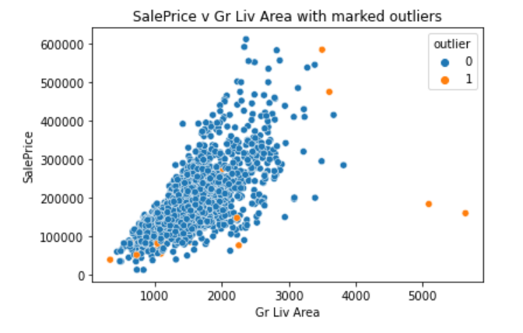
Appendix - Outliers
Identify outliers using IsolationForest

